Slide 1
Build Node Express apps with the Microsoft Graph

Slide 2

Register Azure AD Applications
Microsoft Application Registration Portal
Configure credentials
Select the type of application
Configure permissions

Slide 3
Application Registration Portal (ARP)
Register applications at https://apps.dev.microsoft.com for users to login to the custom application using their Azure AD or Microsoft accounts
Create web applications, native applications (including mobile) and
Obtain application ID and secret for use in the custom code solution

Slide 4
Azure AD Portal vs. Application Registration Portal
Use the Azure AD Portal
https://portal.azure.com
Supports the Azure AD “v1” endpoint
Define scopes / permissions ahead of time
Only supports Azure AD users
Use the Application Registration Portal
https://apps.dev.microsoft.com
Supports the Azure AD “v2” endpoint
Converged authentication – use either Azure AD or Microsoft Accounts for login to application
Supports dynamic consent – define scopes / permissions at runtime

Slide 5
Creating an Azure AD application with the Application Registration Portal

Slide 6
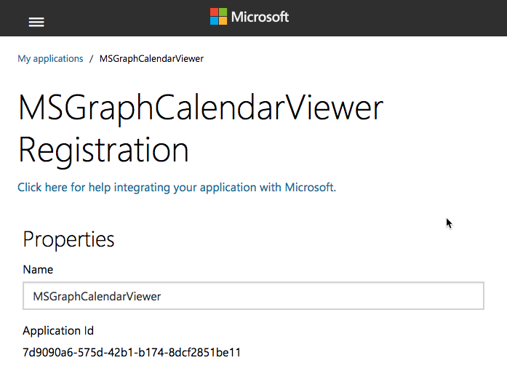
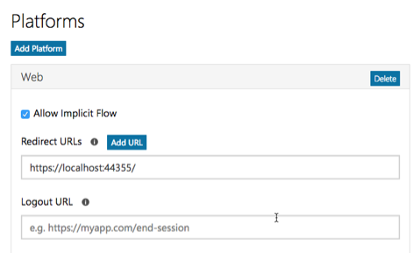
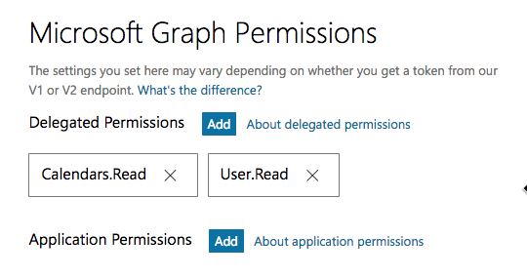
Application registration
Create a new application
Create a new application in the Application Registration Portal. A unique identifier is created for your app.
Add a Web platform
Add a web platform to your application registration.
Add permissions
Add permissions that your application will need if your admin will consent for all users.

Slide 7
Demo

Slide 8
Thank you.

